Slide 1
Hello Sir, remember me?
I’m the man you thought I’d never be. The boy who you reduced to tears. The lad called
‘thingy’ for six whole years.
Yeah, that’s right, my name is Bob, the one who landed the pop stars job.
The one who you told, ‘Look don’t touch,’ the kid who wouldn’t amount to much.
Well I’m here and your still there with your fake sports car and receding hair, dodgy
Farah trousers that you think are smart, married to the woman who teaches art.
Married to the life, married to the school, ‘I want to sing and dance, Sir’, now who’s the
fool?
Sing and dance, you thought I was barmy. Settle down thingy, join the army.
And who are you to tell me this, the dream I want I have to miss.
Sir is God, he’s been given the right, to structure lives overnight.
Now I know, life’s true path! Tanks and guns, that’ll be a laugh!
No, not me, I’m a MEGA-CIVILIAN, I won’t lead my life riding pillion.
But thanks for the advice and I’m sure it will do for the negative d***heads just like you.
As for now, I’ve a different weapon, stage and screen is about to beckon, and as I sit in
first class, ‘B******s sir, kiss my a**!’

Slide 2


Slide 3
The National Programme:
Gifted and Talented education seeks to improve the education of gifted and talented children and young people aged 4-19 in schools and colleges throughout England.
Its core objectives are to:
Achieve significant, measurable improvement in the attainment, aspirations, motivation and self-esteem of gifted and talented pupils and students, especially those at risk of underachieving, including those from disadvantaged backgrounds.
Improve the quality of identification, provision and support in schools, colleges, clusters, partnerships and LEAs, giving priority to the weakest, and develop robust quality standards to support this.
Develop tools, and identify and use levers, to help ensure that every maintained school and college in every LEA is equipped to differentiate teaching and learning to meet individual needs at the upper end of the ability range.

Slide 4


Slide 5

GIFTED & TALENTED HISTORY LESSON!
1992: ‘Very able pupils in maintained primary and secondary schools are insufficiently challenged by the work they are set’ HMI
1997: ‘Provision for very able children, defined as the top 5% by attainment, is a significant weakness in one third of maintained primary schools and 30% of maintained secondary schools’ OFSTED
1997: White Paper ‘Excellence in Schools’ made a commitment to develop a national policy for the education of Gifted and Talented pupils.
1999: The Excellence in Cities (EiC) programme was launched in September 1999 to raise standards and promote inclusion in inner cities and other urban areas. It is a programme that incorporates G & T but was much wider than that.
2004: Children Act. Every Child Matters
2005: White Paper ‘Higher Standards, Better Schools for all’
2006, 07, 08: Revision for G & T identification, register and provision – The National Programme

Slide 6
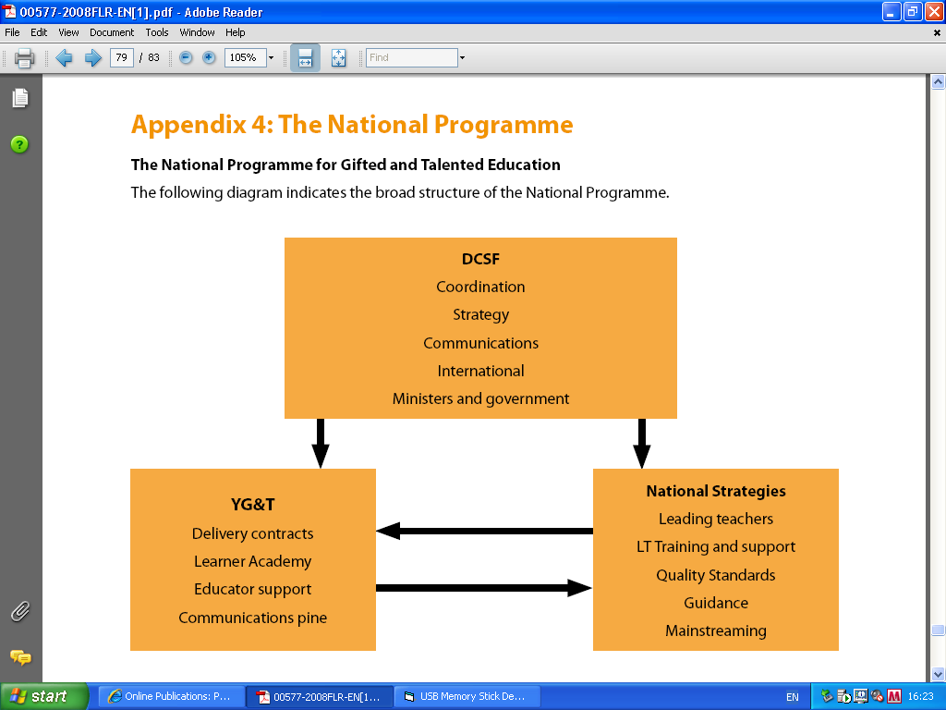




http://ygt.dcsf.gov.uk
http://www.nationalstrategies.org.uk

Slide 7
WHO ARE THEY?
Gifted and talented learners are defined those who have one or more abilities developed to a level significantly ahead of their year group (or with the potential to develop those abilities).
Gifted describes learners who have the ability to excel academically in one or more subjects such as English, drama, technology.
Talented describes learners who have the ability to excel in practical skills such as sport, leadership, artistic performance, or in an applied skill.
Our policy starts from the expectation that there are gifted and talented learners in every year group in every school. It is up to each school to decide on the proportion of their population who are gifted and talented. Since we believe that ability is evenly distributed throughout the population, a school's gifted and talented pupils should be broadly representative of its whole school population

Slide 8
WHAT DOES IT LOOK LIKE IN SCHOOLS?

Slide 9
Headteacher
Research and national and regional initiatives
Other schools via Networks
Lead Teacher
Faculty/Department Heads
Pastoral Heads
Teachers & Non-teaching staff
Students & Parents

Slide 10
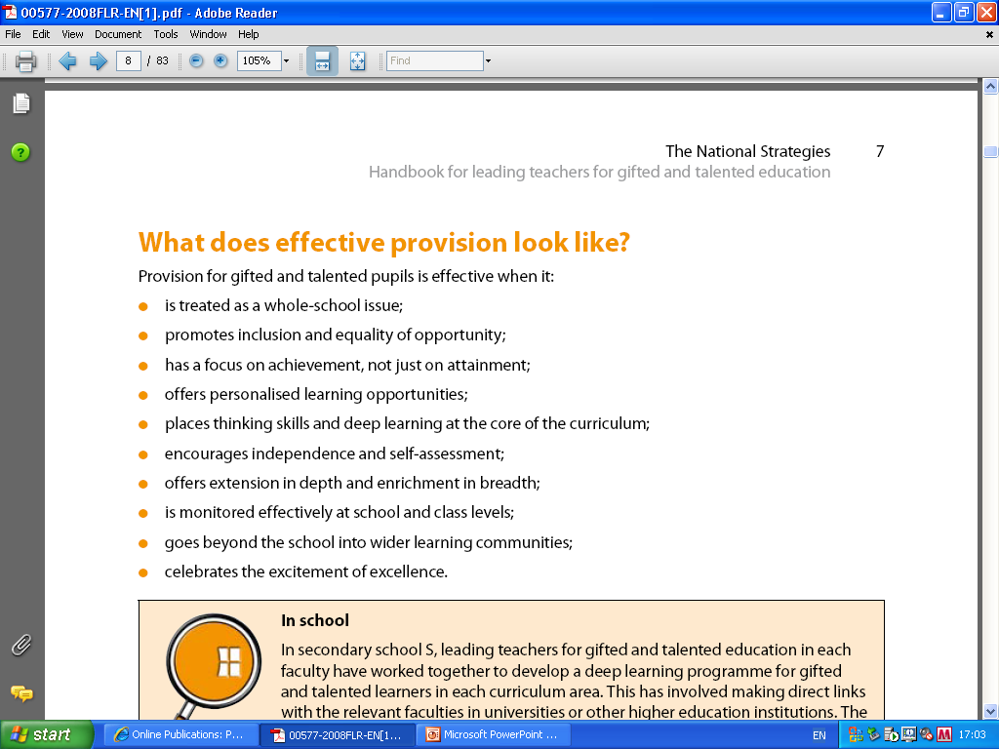

Slide 11
Role of the leading teacher
act as an advocate for the needs of
G&T pupils
ensure that G&T pupils receive appropriate recognition, support and challenge
exemplify effective practice for G&T pupils in their own professional practice, and provide or facilitate coaching/peer mentor support for colleagues
initiate strategies that support the professional development of colleagues to improve schools’ capacity to personalise learning for G&T pupils
work with school leaders to identify underachievement, evaluate provision and plan for whole school improvement
Notes:
This is a challenging role. Ideally it will be a teacher :
who is able to demonstrate classroom practice that effectively challenges, supports and develops the learning of G&T children on a daily basis, and support others in developing this practice
and
who is in a position to work with and support the School Leadership Team in using IQS as a second-level self-evaluation tool to improve G&T provision.
We know that the circumstances of some schools may mean that they are not immediately able to identify someone who has all the experience and expertise required for the role. In this case it will be important to nominate a teacher who has enthusiasm and management potential, who is able to grow into the role and eventually take on all the responsibilities that go with it.

Slide 12
DIFFERENT TYPES OF GIFTED & TALENTED ACTIVITIES IN SCHOOLS
Enrichment: this is when a student is encouraged to go beyond the usual limits of a subject or topic. Enrichment activities might involve extra classroom exercises or more open-ended project work. Enrichment can include work with students from other schools, day and residential field trips.
Extension: this is when students are given activities that develop higher order thinking skills and work practices. Extension activities help students to work with greater autonomy and self-discipline.
Acceleration: this is when a younger student is moved into a class with older students, or when work intended for older students is used in a class of younger students. It may also involve the taking of tests and exams earlier than would usually occur.
EXTENSION IN DEPTH & ENRICHMENT IN BREADTH

Slide 13


IDENTIFICATION
You are going to see 5 slides with information about Gifted & Talented students on them.
After you have read them all you will be asked the following questions:
What questions do you need to be asking yourselves (and others) in order to identify Gifted and Talented students in your classrooms?
What do you need to be doing in order to stretch and challenge the Gifted & Talented students in your classrooms?

Slide 14

HOW ARE THEY IDENTIFIED?
Tests
KS2, KS3 SATS Scores
CATS SCORES – Cognitive ability tests/non-verbal reasoning tests
Departmental tests
Diagnostic assessment
Performance in class – question/answer sessions
Body of work students produce in class
Checking students against subject specific targets
Opinion
Teacher, parental, peer or self nomination

Slide 15
GIFTED AND TALENTED STUDENTS:
think quickly and accurately;
work systematically;
generate creative working solutions;
work flexibly, processing unfamiliar information and applying knowledge, experience and insight to unfamiliar situations;
communicate their thoughts and ideas well;
are determined, diligent and interested in uncovering patterns;
achieve, or show potential, in a wide range of contexts;
are particularly creative;
show great sensitivity or empathy;
demonstrate particular physical dexterity or skill;
make sound judgements;
are outstanding leaders or team members;
are fascinated by, or passionate about, a particular subject or aspect of the curriculum;
demonstrate high levels of attainment across a range of subjects within a particular subject, or aspects of work.
Eyre & Lowe, 2002

Slide 16
GENERAL CHARACTERISTICS OF GIFTED & TALENTED LEARNERS – DCSF, 2008
Give quick verbal responses
Be a good reader
Be artistic
Appear arrogant or socially inept
Be logical
Have a good memory which he/she can access easily
Be musical
Have a wide general knowledge
Communicate well with adults – often better than with their peer group
Excel at sport
Be self taught in his/her interest areas
Have strong views and opinions
Be very sensitive and aware
Be easily bored by what they perceive as routine tasks
Prefer verbal to written activities
Have a lively imagination
Show a strong sense of leadership
Be socially adept

Slide 17
DCSF, 2008
Indicators of gifts and talents – Secondary
Questions rules/authority
Non-conformity
High ability/low motivation
Keen sense of justice
Divergent thinking/creativity
Excellent sense of humour
Growing self determination
May develop lifelong passion for field or hobby
Intellectual curiosity stands out
Exceptional powers of concentration, stamina
Needs to work with learners of similar ability in/out of school

Slide 18
Very able Exceptionally able
Knows the answers Asks the questions
Is interested Is highly curious
Has good ideas Has wild, silly ideas
Top group Beyond the group
Listens with interest Shows strong feelings/opinions
Learns with ease Already knows
Completes assignments Initiates projects
Technician Inventor
Is alert Is keenly observant
Is pleased with own learning Is highly critical
Copies accurately Creates a new design
Good memoriser Good guesser
Answers the questions Discusses in detail, elaborates
Kirklees LEA, 1999

Slide 19
What questions do you need to be asking yourselves (and others) in order to identify Gifted and Talented students in your classrooms?
What do you need to be doing in order to stretch and challenge the Gifted & Talented students in your classrooms?

Slide 20
UNDERACHIEVEMENT
Gifted and talented underachievers may:
Have low self esteem
Be confused about their development and about why they are behaving as they are
Manipulate the environment to make themselves feel better
Tend towards a superior attitude to those around them
Find in adequacy in others, in things, in systems, to excuse their own behaviours

Slide 21
ISSUES
Underachievement
Social and emotional considerations
G & T & SEN
Building relationships with students and parents

Slide 22
WHAT ARE MY RESPONSIBILITIES?

Slide 23
TEACHER RESPONSIBILITIES
In your department
In your classroom

Slide 24
IN YOUR DEPARTMENT
Within your department you may be involved in:
Discussing subject policy on ‘Gifted and Talented’ within context of school wide policy.
Discussing subject criteria for identifying G & T within your subject. http://www.qca.org.uk/qca_2346.aspx
Putting forward the names of ‘Gifted and Talented’ students in your classes and justifying your reasons for suggesting them.
Becoming responsible for managing ‘Gifted and Talented’ within the department. This would involve compiling a subject list of those students identified as G & T, creating subject criteria for identifying G & T, creating resources, monitoring progress of students and feeding back to Co-ordinator in meetings.
Attending ‘Gifted and Talented Group’ meetings.

Slide 25
WHAT CAN I DO TO ENSURE I PROVIDE FOR G & T STUDENTS IN MY CLASSROOM?

Slide 26
YOUR JOB
Understand who is identified as G & T in your classes.
Understand the subject criteria for G & T.
Ensure they are reaching their full potential by incorporating suitable activities in your lessons.
Assess and monitor the progress of these students and feedback to subject leader or Co-ordinator.
Identify others in your classes that may not be on the school or department register. Identify underachievers.
CREATE A CLASSROOM ENVIRONMENT WHERE ALL STUDENTS REACH THEIR FULL POTENTIAL!
ALL STUDENTS FEEL SAFE, VALUED AND WILL TAKE RISKS AND THEREFORE LEARN!

Slide 27
Kerry & Kerry (2000) describe the following as being the key to the teaching and learning of able students.
Defining learning objectives
Setting effective classroom tasks
Differentiating work
Questioning effectively
Explaining effectively
THESE IN MY OPINION ARE THE KEY TO TEACHING EVERY CHILD, NOT JUST THE GIFTED AND TALENTED!!

Slide 28
Classroom considerations
Agreement regarding higher level skills children might acquire within the subject
High teacher expectation
Subject expertise and teacher enthusiasm
Variety in teaching styles and nature of tasks
Teacher-pupil relationship which encourages questions, personal reflection and the formulation of personal opinions
Clear outcomes both generally and for most able
Balance between structure and independence
Recognition of prior learning
Honest feedback and target setting
Assessment which relates to objectives
Interest in teaching and learning, not just the syllabus
Fun and laughter and maybe a little quirkiness
No artificial ceilings
No MOTS (more of the same) or overload
Kirklees LEA, 1999

Slide 30
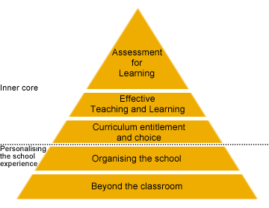
PERSONALISED LEARNING

Slide 31
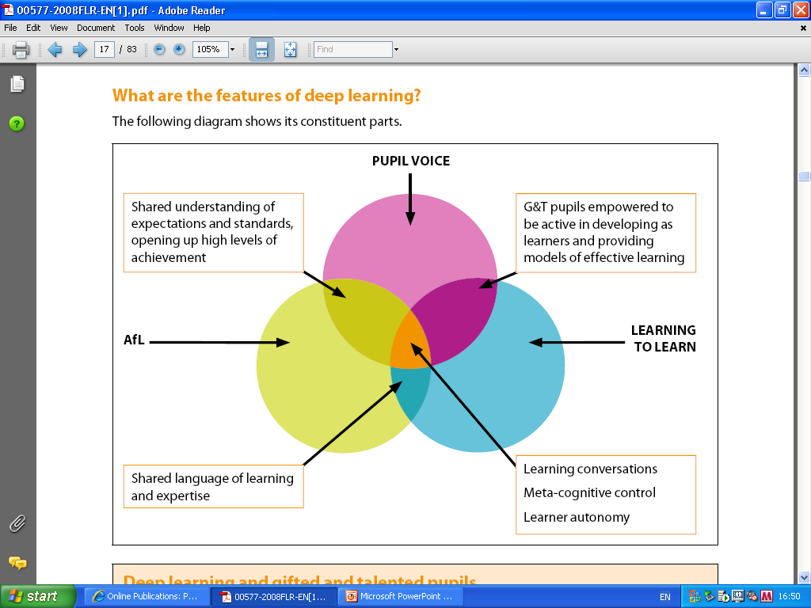

Slide 32

YOUR OWN ‘GIFTED AND TALENTED’ ACTIVITY!!

Slide 33
The learning habits of a pupil engaged in deep learning can be characterised by:
a focus on meaning and argument
relating previous knowledge to new knowledge
bringing together and seeing connections between knowledge from different sources
relating theoretical ideas to day-to-day experiences
relating and distinguishing evidence and argument
organising and structuring content into a coherent whole
an emphasis on pupil reflection
CAN YOU TURN THIS PEDAGOGY INTO PRACTICE RIGHT NOW?
THINK OF A STARTER, ACTIVITY, PLENARY WHICH MAY DEMONSTRATE ONE OF THE ABOVE. DISCUSS WITH A PARTNER AND SHARE WITH US ALL!

Slide 34
ACTIVE ENGAGEMENT
INDEPENDENT LEARNING
THINKING SKILLS
Recommended Publications:
Unit 7 – Questioning DCSF ref 0430-2004
Unit 10 – Group Work DCSF ref 0433-2004
Unit 11 – Active Engagement Techniques DCSF ref 0434-2004
http://publications.teachernet.gov.uk/ OR call 0845 6022260
http://www.standards.dfes.gov.uk/thinkingskills/

Slide 35
PRACTICAL TIPS
Identify Level 8 criteria and A and A* criteria for your subject.
Differentiate aims and objectives.
Seating plan.
Group work.
Differentiate lesson activities/tasks.
Vary nature of activities/tasks.
Extension tasks.
Mind mapping.
Make it real! WIIFM?
On-going projects.
Mysteries!
Model answers.
Peer/self assessment.
‘Out of the classroom’ activities
Metacognition.
Bloom’s Taxonomy/Questioning.

Slide 36
CRITERIA
Key Stage 3
N.C. ‘Gifted and Talented’ criteria
Level 8 and Exceptional Performance criteria
Key Stage 4
Exam board criteria for A and A*
Key Stage 5
Exam board criteria for A.

Slide 37
AIMS
ALL STUDENTS WILL………
MOST STUDENTS WILL…….
SOME STUDENTS WILL……..
ALL STUDENTS MUST……
SOME STUDENTS SHOULD…..
SOME STUDENTS COULD…….
You can also develop separate aims and tasks on worksheet for your G & T group.

Slide 38
SEATING IN THE CLASSROOM
G & T altogether?
Back of room, front or middle?
G & T with SEN?

Slide 39
GROUP WORK
PLAN WELL!!!!!
G & T altogether?
Mixed ability grouping?
What are your learning outcomes?
Curriculum
Skills
What roles?

Slide 40
TASKS/ACTIVITIES
Differentiate 3 ways: SEN, Main body of class and G & T.
Differentiation by outcome, task and support.
Worksheets – Easy to hard

Slide 41
VARIETY IS THE SPICE OF LIFE!
Remember V,A,K.
No MOT’s – More Of The Same!!
Individual/pair/group work

Slide 42
EXTENSION TASKS
Goals for Extension tasks (Eyre 1997)
Critical thinking
Creative thinking
Increased independence
Problem solving ability
Reflection
Self-knowledge
Further reading:
Teachers Toolkit, Paul Ginnis

Slide 43
TOPIC 1
Look at the following statements below about what you need to do to get a certain level for Topic 1 and write them into the correct box.
Draw a rectangle
Draw a rectangle and a square and label the length of the sides
Create and label a reflex angle
Create and label an acute angle
Draw a square
Create and label an obtuse angle
Level 3c | Level 3b | Level 3a | Level 4c | Level 4b | Level 4a

Slide 44
MATHS – ANGLES, TRAINGLES AND QUADRILATERALS
Level | Task
Level 3 – Drawing | Draw a simple plan of a house using some triangles, rectangles, squares.
Level 4 – Drawing and labelling
4c | Label acute, reflex and obtuse angles
4b | Draw and label a scalene, isosceles and equilateral triangle.
4a | Draw and label a set of parallel and perpendicular lines.
Level 5 – Using degrees
5c | Draw, measure and label angles around a point
5b | Draw, measure and label three angles on your design with degrees.
5c | Draw two triangles with construction lines left in. Label the sides in cms and angles in degrees.
Level 6 – Quadrilaterals
6c | Measure and label an alternate and corresponding angle on your design
6b | Draw and label a rhombus and parallelogram. Describe and explain their properties. What special things make them a rhombus and parallelogram?

Slide 45
ASSESSMENT CRITERIA – DEVELOPMENT & BRAZIL
Level | What do I need to do? | Done?
Level 3 Describe | Write about where Brazil is and whether it is a developed or developing country. Say what an urban area is and what a rural area is and given an example of each place in Brazil.
Level 4 Describe in detail | Describe the urban area of Brazil. Describe the rural area of Brazil. (What do they look like? Who lives there? What is the land like?)
Level 5 Describe and start to explain | Describe the lives of people in the rural and urban areas of Brazil. Describe some of the problems people face in both of these areas. Try to explain why these problems exist. Start to use the word ‘because’
Level 6 Describe and explain in detail | Explain in detail why these problems exist in both areas. Suggest solutions to these problems.
Level 7 Analyse and evaluate | Write about many solutions to the problems and exactly how they will improve the lives of people. Make your own suggestions for solutions and evaluate which solution is the best and why.
COULD THIS BE GIVEN OUT AS A HOMEWORK OR REVISION LESSON BEFORE AN ASSESSMENT?

Slide 46
TASK
The next slide has 36 ‘Thinking Words’ on it. These can be used in questioning, writing activities and tasks, pinned up on the classroom wall, revision booklets
WORKING WITH NEIGHBOUR
(preferably from same subject)
Select 10 words from the table that you think are particularly important in your subject across Key Stages 3 & 4. Use your ‘gut’ response.
From those 10 words select 5 that would be the best to challenge G & T students.

Slide 47
THINKING WORDS
analyse | organise | compare
evaluate | summarise | combine
classify | investigate | clarify
justify | experiment | make reasoned judgements
make decisions | deduce | check
explain | conclude | use logical argument
apply rules | collaborate | explore ideas
infer | synthesise | skim
narrow down | speculate | scan
refine | adapt | improvise
identify | practise | vary
select | improvise | listen with discrimination
prioritise | listen for gist | question critically

Slide 48
JOT DOWN THE 5 WORDS
REMEMBER TO USE THEM WITH G & T STUDENTS.
MAKE THEM EXPLICIT AND ENSURE THEY UNDERSTAND THEM – NOT JUST GIVE YOU A REHEARSED DEFINITION OF THEM.

Slide 49
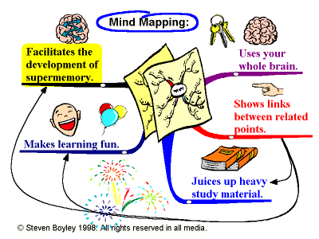

Slide 50
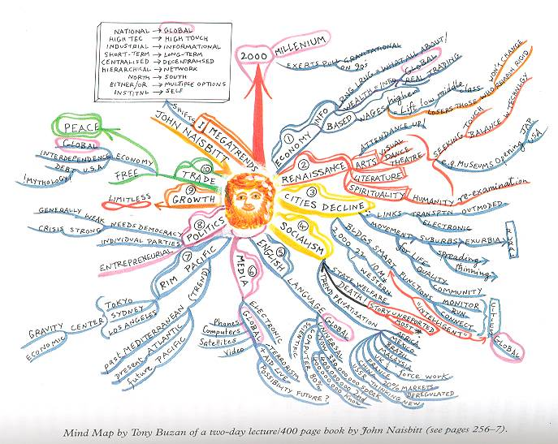
Further reading:
Tony Buzan. Mind Mapping for Kids.

Slide 51
MAKE IT REAL!
WIIFM – What’s In It For Me?

Slide 52

PROJECTS
Design an on-going project linked to the curriculum and subject criteria that G & T students can complete. Completion can be after they have finished work in lessons or at home.
Reward for completion is required.

Slide 53


MYSTERIES!
CREATIVE THINKING
PROBLEM SOLVING
Aim:
To understand how sea stacks are formed.
Aim:
To find out why this piece of rock is stood in the sea.

Slide 54
MODEL ANSWERS
GCSE Geography question
Sustainable development is a term used to describe how economic development can continue without causing too much damage to the environment. Apart from pollution controls, how else can sustainable development be achieved? ( 6 marks)
Model answers
1- 2 marks
3- 4 marks
5 - 6 marks

Slide 55
GCSE EXAM SELF EVALUATION
Exam %age _______
Exam grade________
Areas in which marks were lost | Number of marks lost | Comment/details
Question misinterpreted or misread
Vocabulary in question not known
Did not pay attention to number of marks for question
Did not support answer with case study or example
Did not follow the instruction to describe or explain
Work not understood
Work not revised or not known
Ran out of time
Targets: __________________________________________________________

Slide 56
PEER/SELF ASSESSMENT
My diagram is labelled correctly YES/NO
My diagram has a title YES/NO
My diagram is clear YES/NO
I give myself ____ out of 10 for my diagram.
Next time I draw a diagram I will _____________________
_________________________________________________

Slide 57

‘OUT OF CLASSROOM ACTIVITIES’
Field trips – half-day, day and residential
National Science & Engineering Week (6-15 March 2009)
Fair Trade fortnight (23 Feb – 8 Mar 2009)
Red Nose Day (13 March 2009)
Children’s Book Week – 1st week in October very year
BBC
Subject Associations

Slide 58

METACOGNITION
‘All pupils are capable of thinking about their cognitive processes and making appropriate choices about choosing a learning style that matches the context and content which suits them at that time. This is called metacognition’
THINKING ABOUT THINKING!

Slide 59
METACOGNITION consists of three basic elements:
Developing a plan of action
Maintaining/monitoring the plan
Evaluating the plan

Slide 60
Before
When you are developing the plan of action, ask yourself:
What in my prior knowledge will help me with this particular task?
In what direction do I want my thinking to take me?
What should I do first?
Why am I reading this selection?
How much time do I have to complete the task?

Slide 61
During - When you are maintaining/monitoring the plan of action, ask yourself:
How am I doing?
Am I on the right track?
How should I proceed?
What information is important to remember?
Should I move in a different direction?
Should I adjust the pace depending on the difficulty?
What do I need to do if I do not understand?

Slide 62
After - When you are evaluating the plan of action ask yourself:
How well did I do?
Did my particular course of thinking produce more or less than I had expected?
What could I have done differently?
How might I apply this line of thinking to other problems?
Do I need to go back through the task to fill in any "blanks" in my understanding?

Slide 63

PITCH
TYPE

Slide 64
Individual questioning to promote independent learning
What are you doing at the moment?
This looks excellent. Why have you decided to use this word?
Why have you decided to draw this?
Take me through what you have done so far?
How have you created this?
What did you do first and why?
PLENARY
Ask students to explain to other students what they have done and why.
QUESTIONING IS IMPORTANT –
PLAN THE QUESTIONS YOU WANT TO ASK

Slide 65
BLOOM’S TAXONOMY
This is a classification of levels of intellectual behaviour important in learning created by Bloom and Krathwohl in 1956!
KNOWLEGDE
COMPREHENSION
APPLICATION
ANALYSIS
SYNTHESIS
EVALUATION

Slide 66
 | Task stems | Question stems
Knowledge | Label, describe, define, match, identify | What is the name for..? What is the best one..?
Comprehension | Explain, summarise, translate | How do you think….? What are the key features..?
Application | Predict, solve, use | What do you think will happen?
Analysis | Analyse, explore, relate, separate | What is the evidence..? What does this symbolise?
Synthesis | Design, create, compose, combine | How else could you..? What is your conclusion?
Evaluation | Assess, evaluate, appraise, defend, justify | Which is more….? What errors are there?

Slide 67

Use Whole School Policy and Guidance.
Understand possible characteristics of G & T children.
Underachievement in G & T students – be aware.
Use AFL and Active Engagement Techniques, Independent Learning and Thinking Skills.
Utilise other sources of information/inspiration from outside school.

Slide 68

This Power Point will be available on the Leeds University site from tomorrow. As well as this presentation, there will also be 4 other useful documents.
Bibliography, Q & A sheet on Gifted & Talented, Quality Standards for Schools (IQS) and notes from Gifted & Talented Conference, November 2006.

